Slide 1
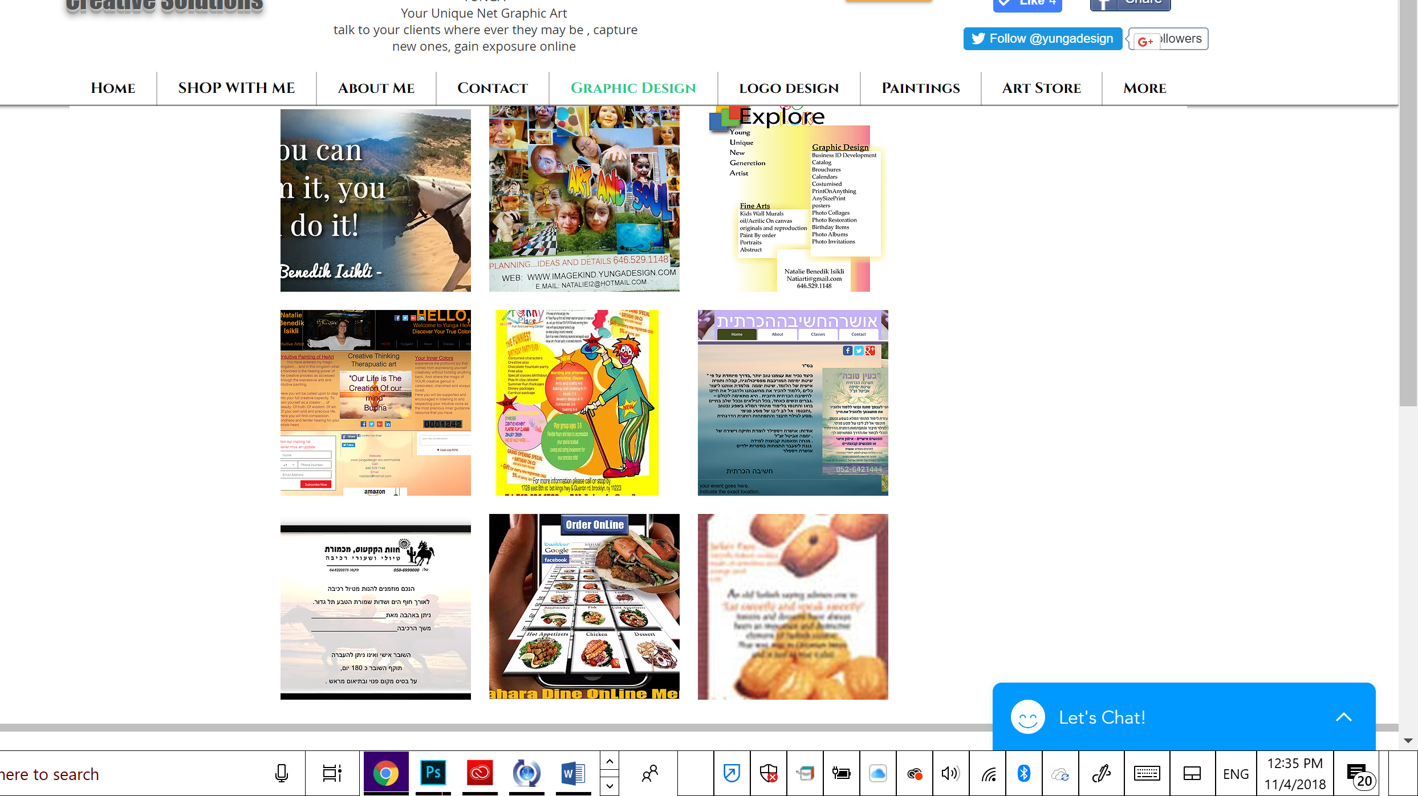
Yungadesign graphic design
Creative services

